Slide 1

HOUSING PRICE PREDICTION
Presented By:
NITISH KUMAR SHARMA

Slide 2
INTRODUCTION
Houses are one of the necessary need of each and every person around the globe and therefore housing and real estate market is one of the markets which is one of the major contributors in the world’s economy. It is a very large market and there are various companies working in the domain.
Housing prices are an important reflection of the economy. House Price prediction, is important to drive Real Estate efficiency. As earlier, House prices were determined by calculating the acquiring and selling price in a locality. Therefore, the House Price prediction model is very essential in filling the information gap and improve Real Estate efficiency.
Data science comes as a very important tool to solve problems in the domain to help the companies increase their overall revenue, profits, improving their marketing strategies and focusing on changing trends in house sales and purchases.

Slide 3
PROBLEM STATEMENT
A US-based housing company named Surprise Housing has decided to enter the Australian market. The company uses data analytics to purchase houses at a price below their actual values and flip them at a higher price.
For the same purpose, the company has collected a data set from the sale of houses in Australia. The data is provided in the CSV file below. The company is looking at prospective properties to buy houses to enter the market.
You are required to build a model using Machine Learning in order to predict the actual value of the prospective properties and decide whether to invest in them or not.

Slide 4
EDA STEPS
We will start by importing the libraries that we require for performing EDA. These include NumPy, Pandas, Matplotlib, and Seaborn for visualization, handling dataset, mathematic computation.
We will now read the train and test data from CSV files into a Pandas DataFrame.
We will display top 5 rows by using .head() function to know if it has the right type to data in it or not.
Using .shape function to display total number of rows and columns present in the train and test dataset.
Using .columns function to display all the features name present in the train and test dataset.
We will now check datatype of each variables of train and test data by using .info() function.
We will now display number of unique values in each features by using .nunique() function.

Slide 5
Then listing out categorical and continuous features from train and test dataset.
Use describe() function to get statistical details like count, percentiles, mean, std, and maximum value of a train and test data.
We will now check for null values in our train and test dataset. We will use isnull().sum() function and visualize it in a plot because dataset has lot of variables. Both train and test dataset has null values, so we will the fill the null values using median and mode.
Now we will do univariate, bivariate analysis on train data to extract information from it.

Slide 6
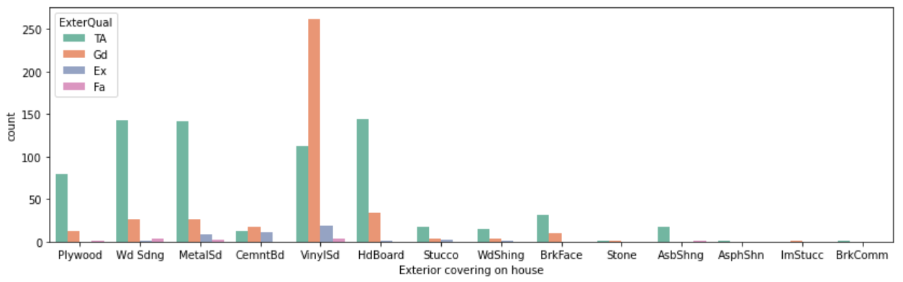
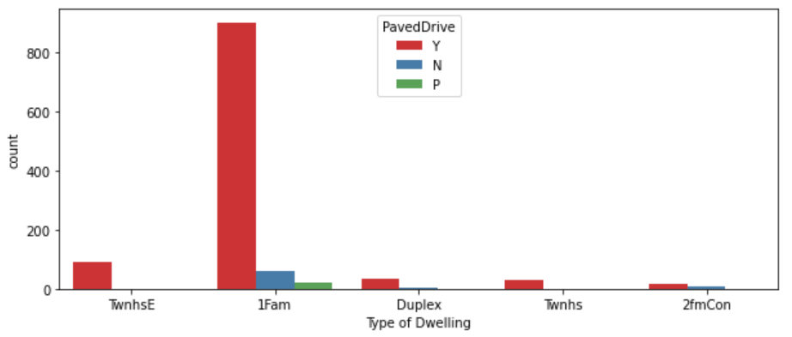
VISUALIZATION
Vinyl Siding is the best among all materials used for exterior covering of houses.
Mostly all type of houses have their driveway paved only.

Slide 7
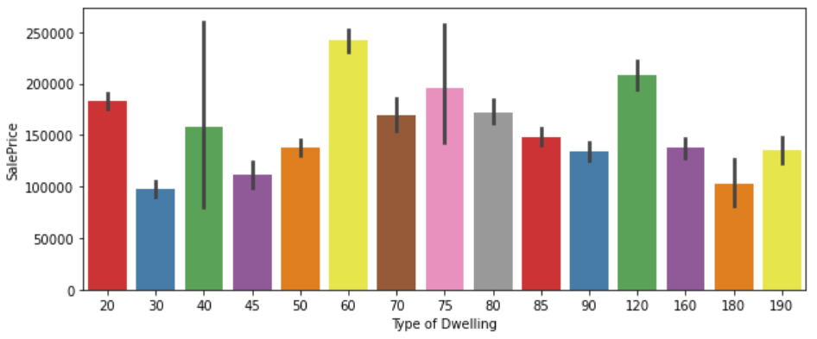
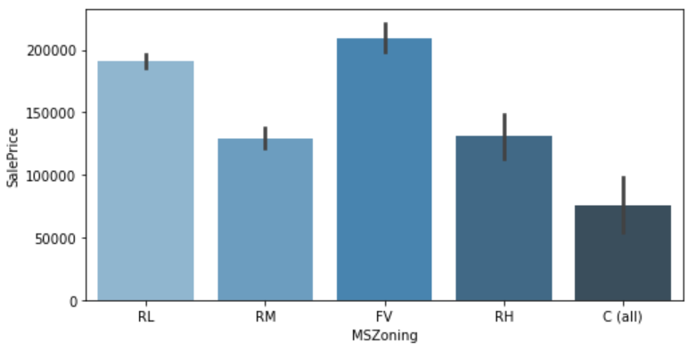
2-STORY 1946 & NEWER type of houses saleprice is maximum than others.
Floating Village & Low Density Residential houses sale price is most than others.

Slide 8
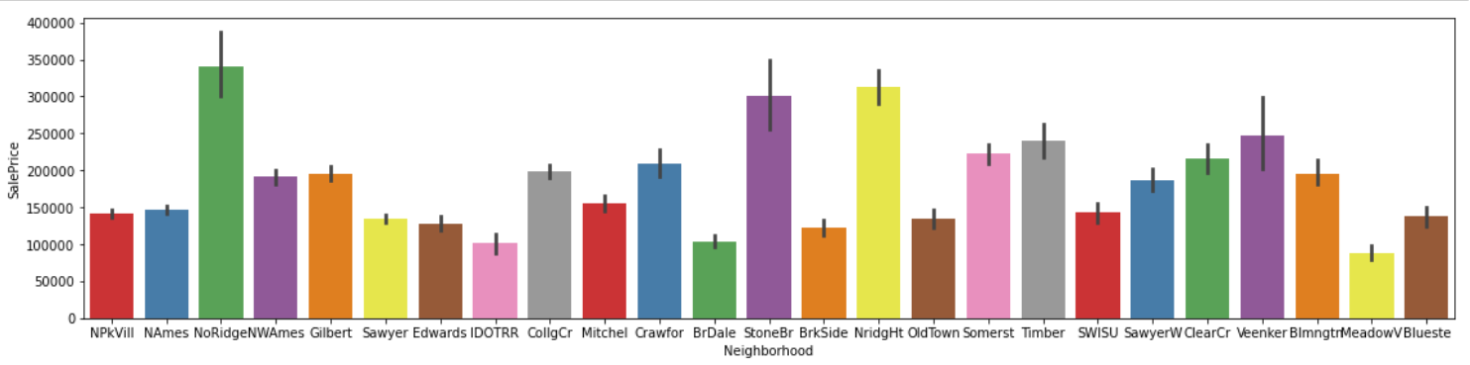
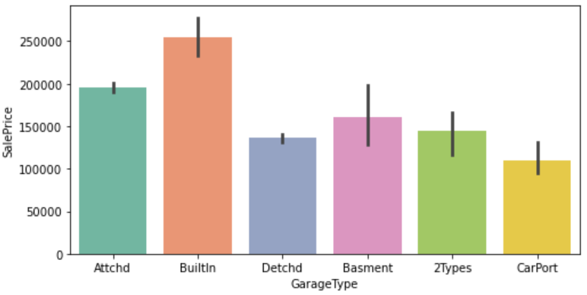
Saleprice of properties located nearby North Ridge is very high.
Saleprice of properties located nearby Meadow Village is least.
Saleprice of those houses are high which has Built-In (Garage part of house - typically has room above garage).

Slide 9
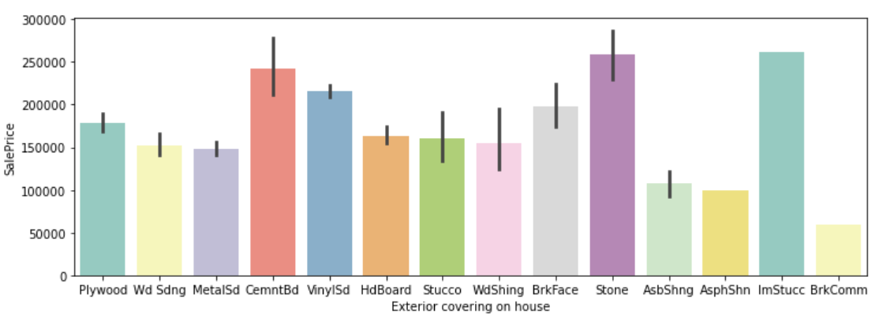
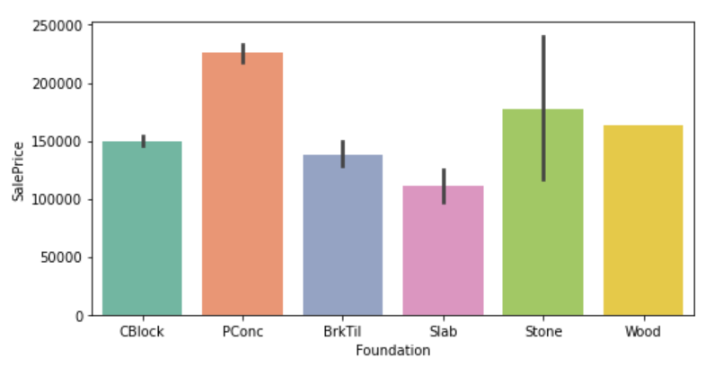
Saleprice of properties is high if its exterior covering is done by stone and cement board.
Those houses whose foundation is built by poured concrete has maximum saleprice than others.

Slide 10
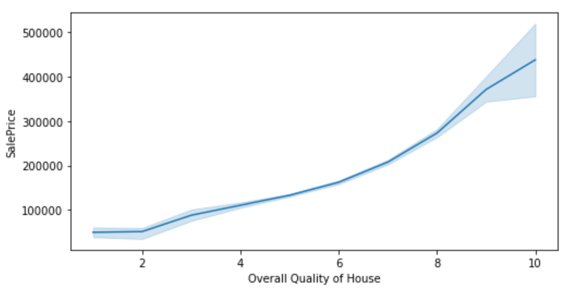
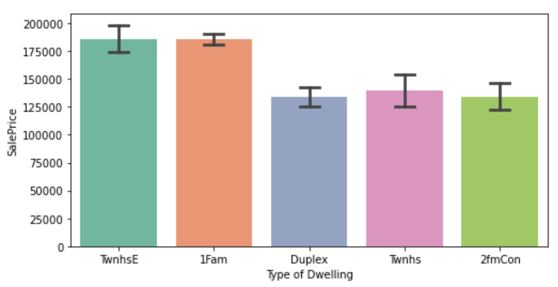
Saleprice of house increases with increase in overall rating for material and finish of the house.
Single family house & Townhouse End Unit types of properties saleprice is much higher than other type of dwellings.

Slide 11
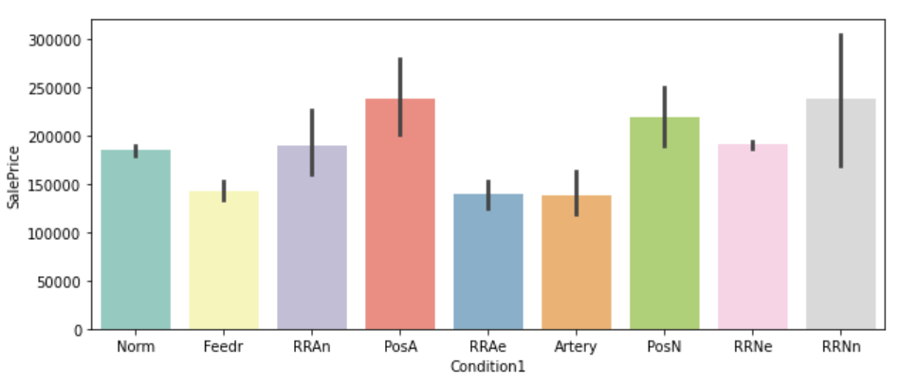
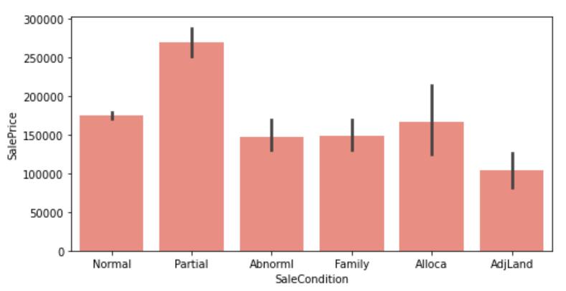
Saleprice of properties is high if located Within 200' of North-South Railroad and also Adjacent or near to postive off-site feature like park, greenbelt etc.
The saleprice of Partial houses which was not completed when last assessed (associated with New Homes) is maximum than others.

Slide 12
STEPS & ASSUMPTIONS TAKEN
After data cleaning, visualized the continuous variables using boxplot for train and test data and the variables were having outliers.
So treated the variables using 1.5 IQR method to remove outliers.
Used label encoder to convert categorical variables of train and test data into machine language.
Plotted heat map to see the correlation of train data variables with the target (Saleprice) variable.
Then removed variables from the train data that were highly co-related to each other by observing it through variance inflation factor.
Then started model building and testing with different algorithms to find best model and finally doing hyper parameter tuning to achieve good accuracy.

Slide 13
IMPORTANT VARIABLES FOR PREDICTING SALEPRICE OF HOUSES
(OverallQual) Rates the overall material and finish of the house
(TotalBsmtSF) Total square feet of basement area
(GrLivArea) Above grade (ground) living area square feet
(GarageArea) Size of garage in square feet
(GarageCars) Size of garage in car capacity
The above features/variables have good positive correlation with target (Saleprice) variable.

Slide 14
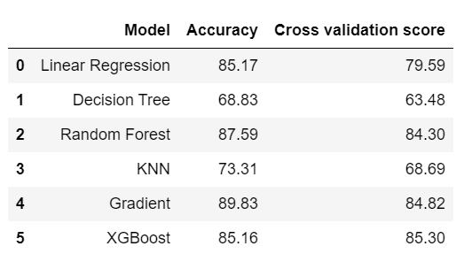
FINALIZED MODEL
XGB Regressor is our best/finalized model to deploy for production because the difference between its accuracy and CV score is least among all models.
After applying hyper parameter tuning on our best model (XGB Regressor) , the accuracy increased by 4.87%.

Slide 15
CONCLUSION
The analysis showed that OverallQual, TotalBsmtSF, GarageCars, GarageArea and GrLivArea variables were important determinants of target (Saleprice) variable.
OverallQual variable plays a huge role in deciding the price of a house.
People do not ignore house foundation material when purchasing a house. High quality house, based on its foundation material, also affects pricing.
Location of properties & accessibility to highway, shopping malls, park, market, hospitals etc plays an important role in affecting house prices.
The newer the house the higher is the price.
Properties size, appeal and usable space is an important element to consider.
Remodelling of houses can boost its value overtime.
If garage, central air conditioning & pool are available then these will have a significant impact on the sale price of houses.

Slide 16
THANK YOU!

